Slide 1

The Guerrilla Approach
Professor Michael Morris
Keough School of Global Affairs
University of Notre Dame

Slide 2
Guerrilla behavior
Guerrilla warfare is the unconventional warfare and combat in which a small group of combatants use mobile tactics in the form of ambushes and raids to combat a larger and less mobile formal army.
Taking advantage of your surroundings—your environment
In marketing, an unconventional system of tactics that relies on time, energy and imagination rather than a big budget. The efforts are unexpected and unconventional, potentially interactive and consumers are targeted in unexpected places.

Slide 3
Guerrilla Marketing--defined
Guerrilla marketing means marketing that is unconventional, non-traditional, unexpected, creative, low cost, not by-the-book, and extremely flexible
Marketing that is built around bootstrapping, leveraging and stretching

Slide 4
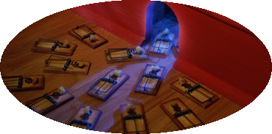
Guerrilla behavior
Doing more with less
Using other people’s resources
Non conventional media
Creative ways to influence word of mouth
Tapping underutilized resources
Partnering, reciprocity and barter
Networking, viral and buzz marketing
Database marketing
Finding ways to talk one to one
What makes it guerrilla?
…Think strategically, act like a guerrilla

Slide 5
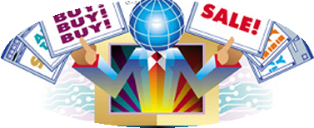
Sample Guerrilla Ideas
Barber shop advertises on the ceiling
Hair dressers invited to exclusive party at restaurant
Locate “champions” (key clients) for your business and give them something special
Students wear your stuff
Create news: computer training for underprivileged kids, make predictions, do something incredible
Chalking the sidewalk

Slide 6
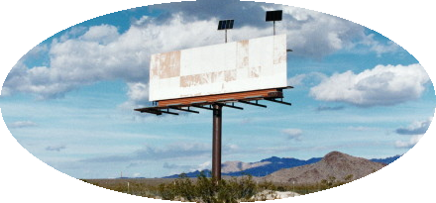
Sample Guerrilla Ideas
Active involvement in community groups
Reciprocal advertising – you mention me and I’ll mention you
Barter for unutilized space (windows, table tents, bulletin boards, dressing room mirrors)
Write articles for newspapers
Bumper stickers on cars
Fish & chips shop finds people
waiting in lines (at ATM’s or other places)
and gives them coupon looking like a fish
with a connect the dots game on it

Slide 7
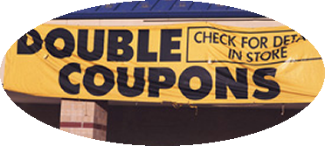
Sample Guerrilla Ideas
Discount card/coupon that appreciates in value
Theatre with speakers out front (bakery with smells)
Ads in local newsletters/company newsletters/church bulletins
Airbnb does co-marketing campaign with Stayfree Feminine Pads to emphasize to women how clean and safe their accommodations are;
Buzz marketing with models at coffee shop
Flowers on retailer tables

Slide 8
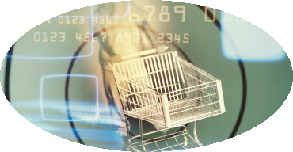
Sample Guerrilla Ideas
Mattress retailer sleep over
Huffington Post – What Time is Superbowl?
Donuts for car repair shops
Mrs. Field Cookies---free cookies to blood banks
Creative handout - at places where your targeted customers frequent
Pizza place cleverly employs the homeless around town to hold up signs with humorous message about the pizza place;

Slide 9
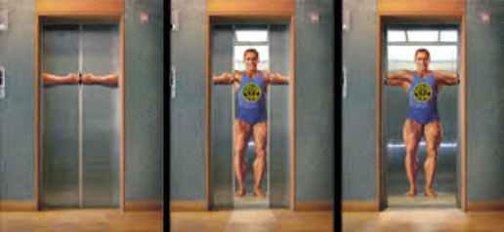
Techniques
Barter: Luvuyo
Co-marketing and Reciprocity: Varsity Theater
Sharing: Machines during downtime
Opinion leaders: RIP clothing
Take advantage of surroundings: Flower lady or Bongo or pizza guy in Portland
Untapped resources you do not own: Elevator (or any) doors or inserts into newspapers or hairdressers
Untapped resources you do own: Enterprise
Networks: Get a Room guy and speaking
Co-creation: YDE
Create missionaries: CAiCE User Groups
Surprise: Jewelry store-free diamonds
Place products: Harley
Create news: Free computer training for inner city youth
Disguise and stealth: Camera and tourists

Slide 10

Dancing: The Guerrilla Way

Slide 11
Guerrilla Budget: Local environmental nonprofit ($2,500 Monthly)
Marketing Method | Monthly Cost | Comments
Personal Letters | $120 | 250 personal letters mailed to key influencers
Circulars | $30 | Cost of $360 yearly, amortized
Brochures | $80 | Cost of $960 yearly, amortized
Sign on Bulletin Boards | $30 | Monthly fee to have company’s flier posted
Social media messages with boosts | $150 | Three times per week
Classified Ads | $40 | Uses one newspaper twice a week
Yellow Pages | $30 | Medium listing, one directory
Newspaper Daily Ads | $940 | One ad weekly, two newspapers
Magazine Ads (1 time) | $100 | One full-page ad in Time, amortized over 1 year
Bumper stickers | $120 | Printed and put on vehicles of friends, family, others
Radio Spots | $400 | Spends $100 weekly; on one FM station
Direct Mail | $100 | Postage only, since company mails circular
Advertising Specialties | $30 | Cost of computer-oriented calendars
Free Seminars | $0 | Distributes brochures at these
Sampling | $0 | Offered to corporations
Production | $200 | Amortized over 1 year – production of circulars, brochures, ads,
On-line Classified Ads | $0 | Placed in four different categories
Total | $2,370

Slide 12
How Harley Does Guerrilla
Appear in other people’s ads
On the field at halftime of the Super Bowl
Sponsorship of clubs
Road rallies
Biker gatherings (e.g., Daytona)
Employees wear the clothing
Factory tours
Market research from riding with customers
Strong interaction with and support for dealers

Slide 13
Harley—Creating The Community
They don’t try to define the mystique
They play on the desire for freedom and action
The owners and employees are customers
Fundamental belief that there is no substitute for the best
Refuse to act like the competition
Sense of emotional bond

Slide 14
3 Questions to Guide Your Efforts…
What internal resources do we have that we are not fully utilizing?
Are we making full use of our website, packaging, vehicles, sales and service people, or any other assets under our control?
How well are we leveraging relationships with people or organizations in our network?
Look at relationships with suppliers, vendors, producers of related products, financiers, distributors, customers
What untapped or underutilized resources exist in the community or marketplace?
Kids who are opinion leaders, houses on prominent corners, walls in restrooms, table tops, car bumpers, abandoned buildings, school kitchens during summer, stay at home moms or dads

Slide 15
Two Key Principles
Resource leveraging
e.g., use of manuf. Reps, trade outs for promotions, borrowing models, outsourcing customer service, lease a designer, use students from local design school, borrow
Risk management
e.g., test markets, trial runs, more focused distribution channel rather than broad, slower roll-out, lease facility in cheaper part of town, convert fixed costs into variable costs

Slide 16
Emerging Guerrilla Forms…
Viral Marketing: attempts to get individuals to pass along a marketing message to others, creating a potential for exponential growth in message exposure and influence
Buzz Marketing: creating and leveraging a ‘buzz’ by generating excitement, infatuation, missionary zeal through some sort of grassroots initiative

Slide 17
Some principles in viral efforts:
Give away products or services- free is a beloved word (Jimmy Johns)
Provide for effortless transfer to others
Ensure it scales easily from small to very large in terms of moving from server to server
Exploit common motivations and behaviors (greed, fear, desire to be loved, popular or understood, desire to be cool)

Slide 18
Some principles in viral efforts:
Utilize existing communications networks (each of us has a network---think just of a waiter’s or waitresses contacts)
Boost activity by using paid influencers

Slide 19
Buzz Perspectives (from M. Hughes)
Six buttons of buzz:
The taboo (sex, lies, bathroom humor, etc.)
The unusual
The outrageous
The hilarious
The remarkable
The secret (both kept and revealed)
Capture media attention
Most written stories: David and Goliath story (human interest), unusual or outrageous story, controversy story, celebrity story, whatever’s hot right now
Scarcity and mystery
Put messages in uncluttered media/spaces

Slide 20
Buzz and Viral: Honest Tea
Honest Tea—Most honest city in America:
http://adsoftheworld.com/media/ambient/honest_tea_the_most_honest_city_in_america
United Nations –Dirty Water Campaign:
https://brogan.com/blog/guerrilla-marketing-example-2-unicef-dirty-water-campaign/
United Breaks Guitars
https://www.youtube.com/watch?v=5YGc4zOqozo
West Jet and Christmas
https://www.youtube.com/watch?v=zIEIvi2MuEk
Vespa best video competition:
https://www.youtube.com/watch?v=6Rm-eLM3opw

Slide 21
Low income entrepreneur: Kelli
Mahogany Maternity
Mahogany Maternity is set up as a nonprofit entity that provides pre and post-birth services, which includes but not limited to private classes on birthing and early infant care, birth classes, milk banks, and lactation consulting. It is registered with EIN, has a tax-exempt status, and is Lamaze certified. The organization has a website and provides breast pumps to women for free. She needs to help selling the services.
Push or pull?
Identify a creative guerrilla tactic

Slide 22
Low income entrepreneur: Ava
Beautiful People
Beautiful People is a home-based business involve in making baby bibs. They produce baby bibs in 3 different styles – full, bandana or regular. Most have animal designs on them. She is also involved in making adult bibs (for the mentally challenged). The business currently has 5 sewing machines, a heat seal press and only one staff (the sole proprietor). However, she plans to train young girls to operate the sewing machines.
Does she focus on direct sales or through stores?
What are some guerrilla tactics?

Slide 23
Low income entrepreneur: Traci
Younigue Boutique
Younique Boutique is women’s apparel boutique with unique international clothing. Traci worked for the previous owner for 8 months before taking over at no cost. The Boutique is located behind South Bend Chocolate Café in downtown South Bend. Her rent is $1800 a month but includes all unitilies. She has no other source of income and the CoronaVirus restrictions are killing her---she likely cannot cover the May rent.
What’s a buzz marketing tactic to drive traffic if she can get through the business shutdown?

Slide 24
Low income entrepreneur: Sammy
Green Earth Bike Rentals
Green Earth Bike Rentals is an on-demand bike rental company. Costumers make reservations and pay online. The company delivers bikes on request and retrieves them at the end of the contract (hourly, daily, weekly). Sammy has acquired 30 bikes over the past three years and fixed them up. The business is based in a garage near two bike trails, and is planning to acquire baskets. The company charges the daily rate of $22, and efforts are being made to register the company.
How can we get a viral campaign going for Sammy?

