Slide 1

WrightWay2Go
A MARKET INTRODUCTION & ANALYSIS

Slide 2
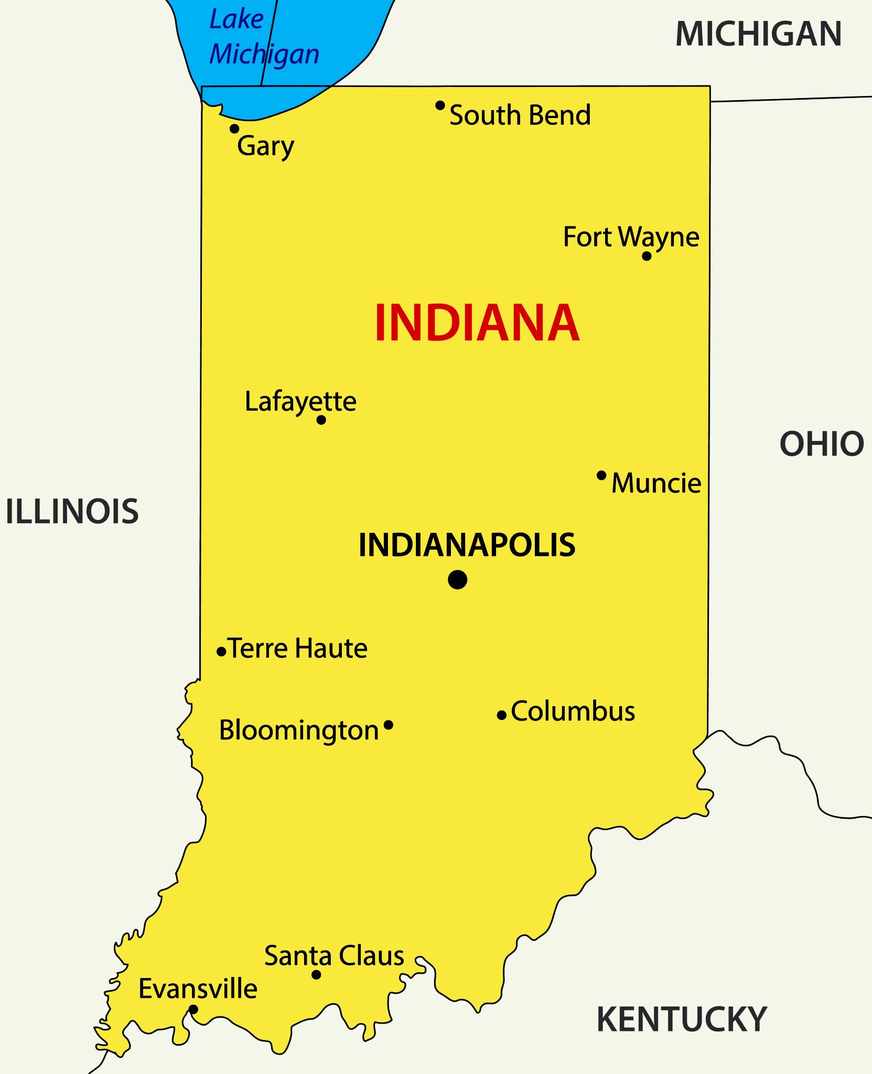
RELEVANT MARKET
for an accounting firm targeting small businesses in SB and Indianapolis
The firm serves both B-B and B-C in terms of business bookkeeping, personal taxes, and familial taxes.
South Bend and Indianapolis are the two cities in focus for the firm.
Dual city focus
Small businesses (10-49 employees, <$500k AR), low-income to middle class individuals and families.
Clients have a basic to intermediate understanding of financial knowledge.

Slide 3
MARKET SIZE AND POTENTIAL
29% of 99k small businesses in Indianapolis and South Bend use accountants.
$50.9M
ESTIMATED ANNUAL MARKET POTENTIAL
29K
SMALL BUSINESSES
$1.7k
AAS on Accounting Services
X
29k small businesses is a combined total of those in Indianapolis and South Bend that use external accountants.
Estimated AAS (Average Annual Spending) on accounting services per small business.

Slide 4
CUSTOMER BUYING PROCESS
1
2
3
NEED RECOGNITION
INFORMATION SEARCH
ALTERNATIVE
EVALUATION
4
5
PURCHASE DECISION MAKING
POST PURCHASE EVALUATION

Slide 5
Let’s apply it to the business:
NEED RECOGNITION
Clients are…
Spending too much time on accounting and not enough time on their business
Struggling to understand their financial statements
Making financial mistakes
Unsure of how to comply with tax laws and regulations
Planning to grow their business

Slide 6
Let’s apply it to the business:
INFORMATION SEARCH
Once small business owners have recognized the need for accounting services, they will begin to search for information about potential accounting firms.
They:
Ask for recommendations from friends, family, and other business owners
Search online for accounting firms in their area
Read reviews of accounting firms
Contact accounting firms to learn more about their services and pricing

Slide 7
Let’s apply it to the business:
ALTERNATIVE EVALUATION
Once small business owners have gathered information about potential accounting firms, they will begin to evaluate the alternatives.
They consider the following factors of the firm:
Experience with small businesses in their industry
Reputation and customer reviews
Range of services
Pricing
Location and convenience
Notes:
-Ease of doing business

Slide 8
Let’s apply it to the business:
PURCHASE DECISION MAKING
Once small business owners have evaluated the alternatives, they will make a purchase decision. They choose to hire the accounting firm that they believe is the best fit for their needs.

Slide 9
Let’s apply it to the business:
POST PURCHASE EVALUATION
After small business owners have hired an accounting firm, they will evaluate the services they receive.
They consider the following factors of the firm:
Responsiveness to their needs
The quality of the firm's work
Communication style
Ability to help them save money on taxes
Ability to help them grow their business

Slide 10
MARKETING: THE 4 P’s
The 4 Ps of marketing are important in reflecting the customer's buying process because they address the key factors that customers consider when making a purchase decision:
Product
What do we do for the customer?
Promotion
How does the customer learn about it?
Price
How much does the customer pay for it?
Place
When and where does the customer receive the product or service?

Slide 11
Product
The product in this case is accounting services, which include bookkeeping, payroll, tax preparation, financial planning, and business consulting.
Promotion
Accounting firms can use advertising to reach a large audience, utilizing public relations tactics and an online presence to connect with potential customers and educate them about the services.
Price
Accounting firms can use a variety of pricing strategies, such as hourly rates, monthly retainers, and project-based fees.
Place
Accounting firms can distribute their services through a variety of channels, such as their website, phone, and in-person meetings. Accounting firms can also partner with other businesses.

Slide 12

BUYING BEHAVIORS
PRICE SENSITIVE
Small businesses often have limited budgets, so they are looking for accounting services that are affordable.
VALUE CONVENIENCE
Small business owners are often busy with their businesses, so they appreciate accounting firms that are easy to work with and that can provide services remotely.
EXPERTISE
Small business owners want to work with accounting firms that have experience working with their industry and can help them with their specific accounting needs.
RELATIONSHIPS
Small business owners want to work with accounting firms that they can trust and that they can rely on for advice and support.

Slide 13
THE “BUYER”
Who buys? Who is the decision maker?
The decision maker for accounting services in small businesses is typically the owner or manager of the business because small businesses often have limited resources and staff, so the owner or manager is often involved in all aspects of the business. Let’s take a look at principal buyers:
Small Business Owners
They need accounting services to help them keep track of their finances, prepare taxes, and make informed financial decisions.
Startups
Startups need accounting services to help them set up their financial systems and track their expenses.
Growing Businesses
Growing businesses need accounting services to help them manage their finances and scale their businesses.
Expanding Businesses
Businesses that are expanding into new markets need accounting services to help them set up their financial systems in the new market and comply with the local tax laws and regulations.
Accounting firms can target these principal buyers with their marketing and sales strategies. For example, accounting firms can offer free consultations or assessments to small business owners and startups. Accounting firms can also create content that is relevant to the needs of growing businesses, such as articles and blog posts on topics such as financial planning and tax compliance.

Slide 14
WHY IS THIS PROCESS SO IMPORTANT?
The target market you choose will determine how your business works. Specifically, it will determine how much you work, how much revenue your business generates, how you market, and more. In fact, your target market in many ways will shape the way your business operates on a daily basis.

