Slide 1
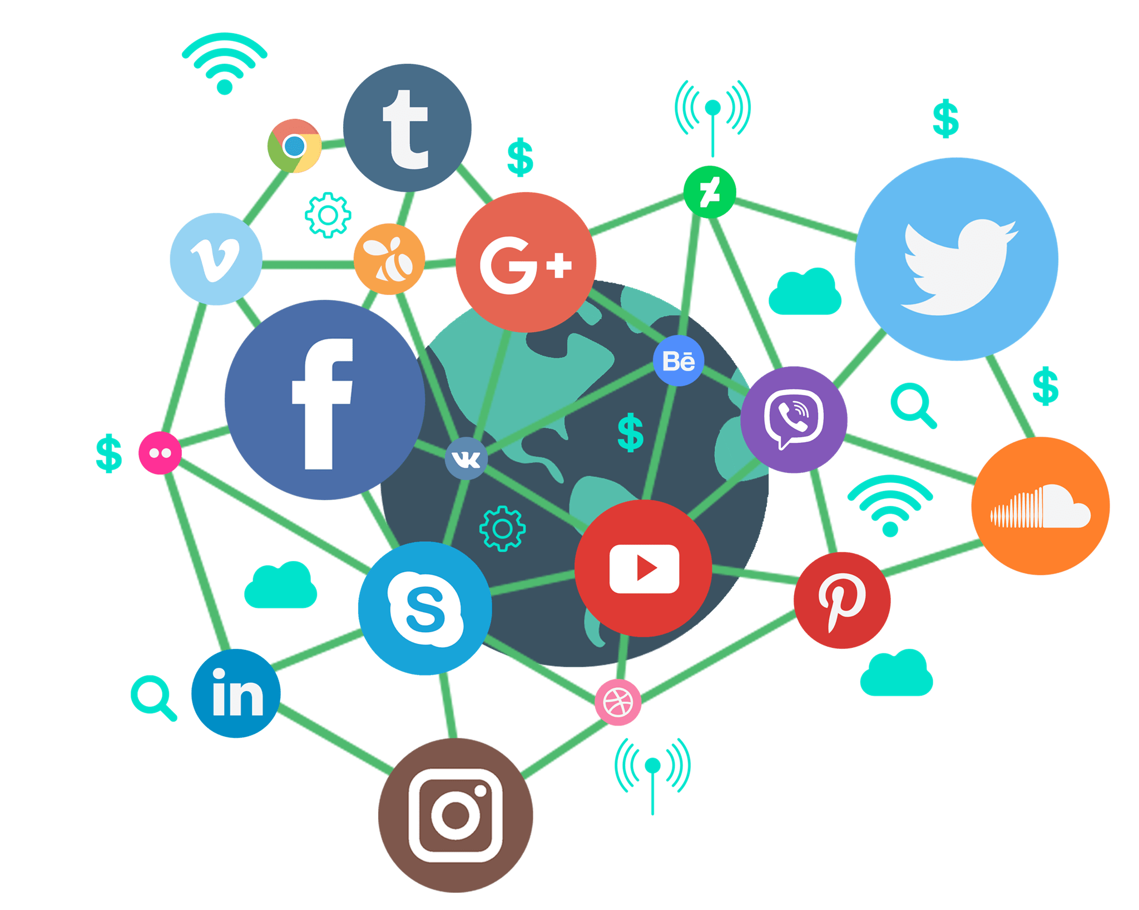
Utilizing Social Media
for your Business
Notes:
How many of you are using social media for personal? Business? Keep your hands up if you’re on 1 platform…2….3….?
This is a massive space.
81% of the US population is using Social Media – over half are on more than two platforms
People are using social media to make purchasing decisions!
Buyers are spending 20% - 40% more money on companies that use social media marketing
71% of consumers who have had a positive experience are likely to recommend the brand on their social media platforms

Slide 2
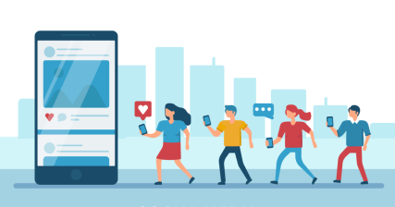
Why?
Expose business to new markets and demographics
A great way to interact with customers
Generate good word of mouth about your business
Immediate communication
Don’t need to spend any money (but do need to spend time)
Notes:
Social media is a very popular and useful way to expose your business to new people and potential customers
Very easy way for customers to interact with your business
Post and tag you/reposting
Builds customer loyalty
generate good word of mouth about your business
get customer feedback
immediate communication
(without spending money but spending time) willingness to spend time is key
emphasize effectiveness of social media is tied to the care and frequency of your posts on a given platform

Slide 3




Introduction to
Notes:
The amount of social media platforms may seem infinite and overwhelming but there is no need to present on all of them
Depending on what your business is and who is serves; one or two social media accounts should be all you need
I’m going to introduce to you 4 of the biggest social media platform that I think would prove most useful and easiest to use to

Slide 4
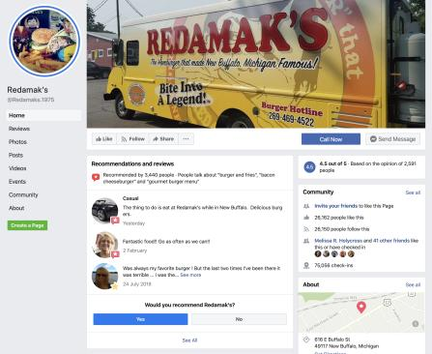
Facebook
Biggest social media network worldwide
Safe Stand-by
Great for:
Creating a visual, online presence
Events and promotions
Building community
Connecting with the local community
Facebook Messenger
Communicate with customers and other businesses
Notes:
Facebook has 2.8 billion users
Generally middle-aged to older people are most active on Facebook but people of all ages and markets are on it
It’s great for creating a visual presence
You can post pictures, videos, updates, events, promotions
Customers can like it and give reviews
Allows for community to from around your business
Easy to access information about the business, such as address, phone number, etc.
Facebook also has a messenger feature that allows direct contact with customers and other businesses
Could reach out with questions and concerns
safe stand by
how to boost posts - how reach particular people
tonya microblading - 3 audiences - women with cancer - reach them

Slide 5
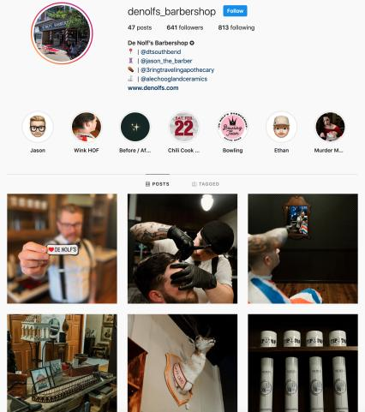
Instagram
General Audience:
Millennials and teens (under the age of 25)
Great for:
Visual and creative businesses
Sharing visuals; photos and videos
Organic growth
Hashtags
Competitions
Stories
Notes:
stress visuals

Slide 6
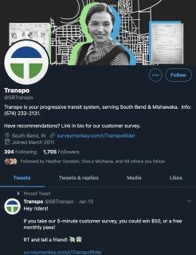
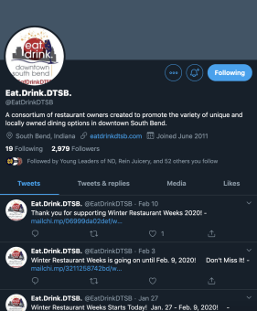
Twitter
General Audience:
Teenagers and Millennials
Great for:
Immediate updates (aka “Live-Tweeting”)
Customer engagement
Very interactive
Fast-paced
Timely
Notes:
Twitter is a fast-paced, more casual platform
Mostly used by teenagers and millennials
Great for real-time updates; news, promotions, events
Interact with customers and other business; re-tweeting, liking, etc.
Can do Q&As, polls, etc.
Could be used with humor; good for setting a tone for the business
Short and sweet; tweets with less characters and pictures get more engagement
immediate timely

Slide 7
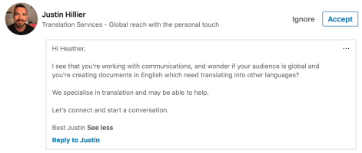

LinkedIn
Audience:
Those in the working world (or close to it)
Businesses
Great for:
B2B small business engagement
Recruiting employees
Notes:
Downsides:
Upgrade to send InMail – relies on on tailored connections
Paid advertising is not as advanced
Not the best for large-scale marketing
To make business contacts
B2B emphasize

Slide 8
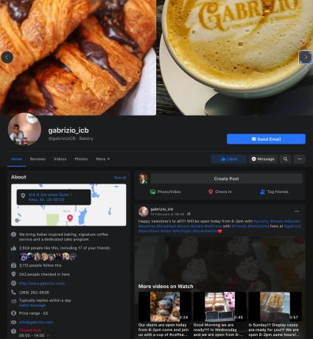
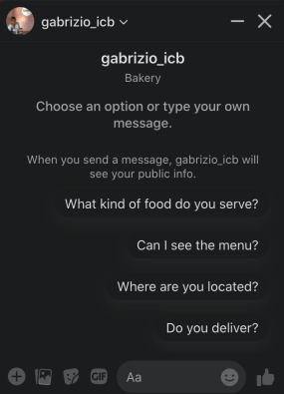
Example of How to Utilize Facebook
Notes:
create business page rather than personal
We’re gonna take a look at how a local business uses Facebook and Instagram to enhance their business, which I would say are the two best platforms to start on
Gabrizio is a local Italian bakery in Niles, Michigan that sells coffee and treats
The picture on the left is there main profile page of the business, which we’ll take a closer look at next, and on the left is the facebook messenger feature I mentioned earlier
It allows other users to directly message your business with any questions they may have
Makes your business more accessible and creates a relationship with your consumers

Slide 9
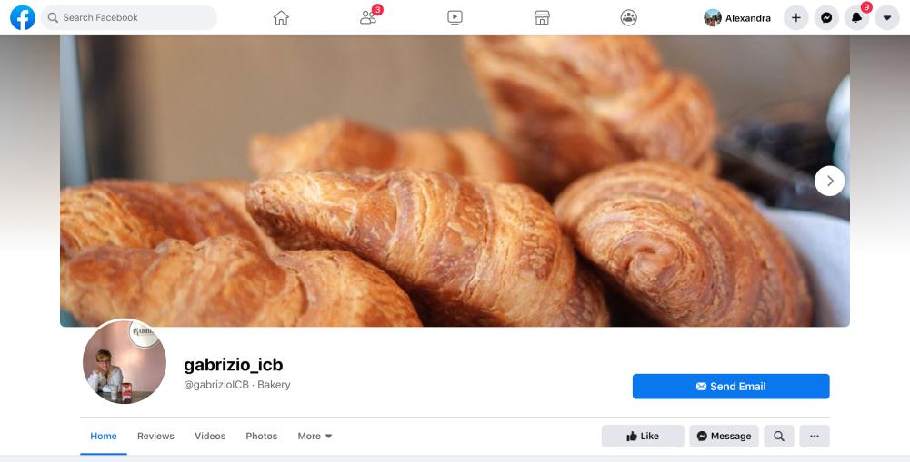
Notes:
This is the top of the cover page, it is what gives a user a first impression of your page and business
Having a high quality cover photo that correctly depicts your product or service gives users a better and quicker understanding of your business
Also attracts more engagement
I recommend using a profile picture of you logo to keep it professional
You can also see buttons that allow customers to contact and engage with your business
If you connect your business email, they can email you directly
You can also see the messenger button and like button
You can also see the different tabs to your page
You get to decide what you want to put, including the ones under more
As you can see there are tabs for review, videos, photos, but you can also put other like events and community ; we’ll get into those in a little bit

Slide 10
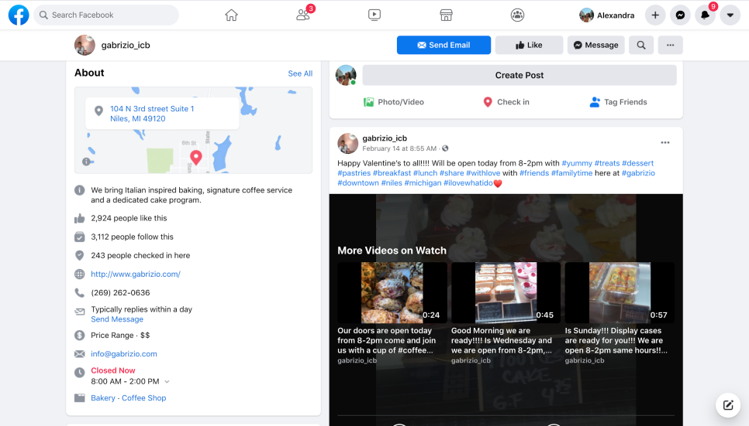
Notes:
Scroll down and we’ll see the about section; which contains valuable information regarding your business: a little biography, address, website, phone #, hours of service, etc.
importance of consistency - videos are suggested

Slide 11
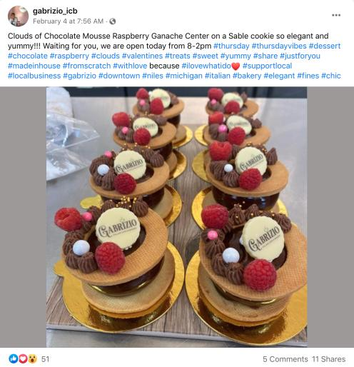
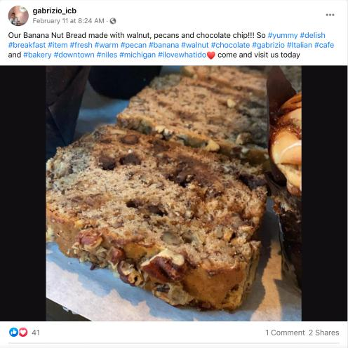
Notes:
Here are two examples of posts
Both are good pictures of what they offer and a small description of it
You can also see the use of hashtags
Hashtags are a way of grouping related tweets together
Makes it easier for users to discover content related to specific topic
For example if we were to click on #chocolate a ton of chocolate posts would appear
So it’s good to put a few of related topics to your business or post; not too much or it can be overwhelming
You can also post videos
Users can react to the post as well as comment and share it

Slide 12
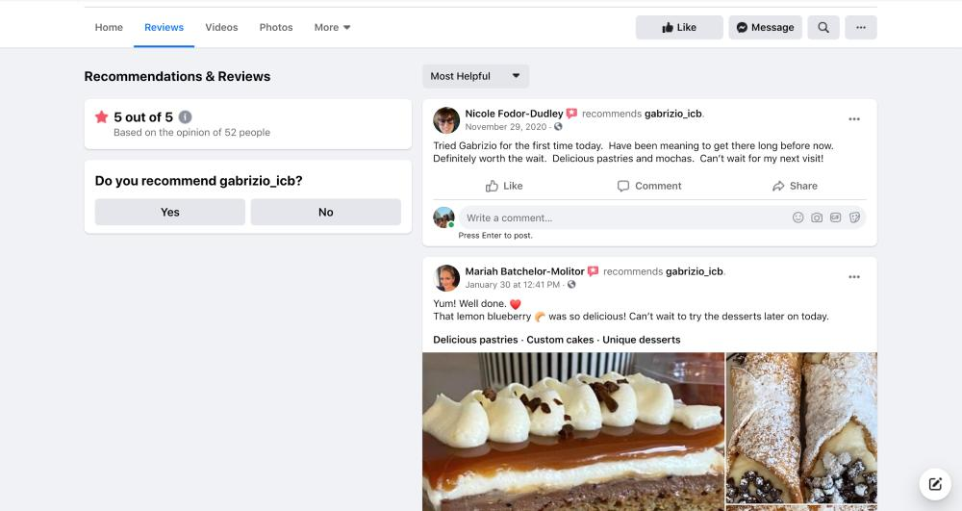
Notes:
That would all appear on your homepage
The next tab you could find all the recommendations and reviews of the business
Good tool for other users to see if they would like to attend or use your business
The next two tabs just culminate all the videos and then all the photos that you have posted to make it easier for users to look or search through them

Slide 13
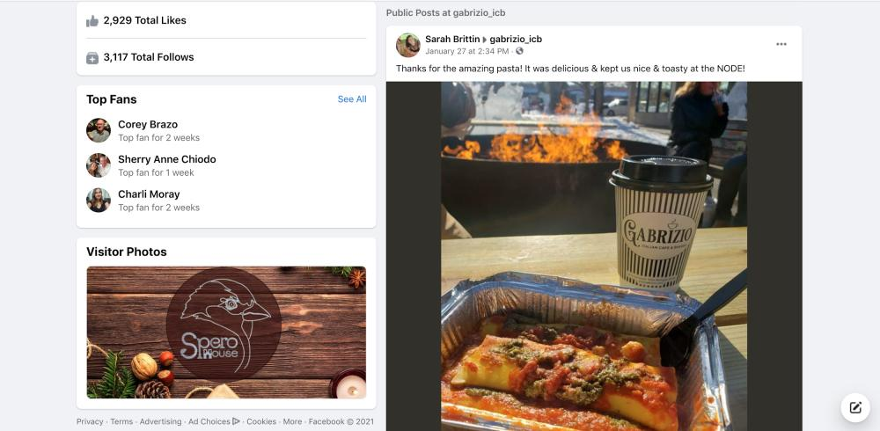
Notes:
Under Gabrizio’s more tab, theres an about section, which essentially repeats the information we saw on the home tab and a few extra details, and a community page
In the community page we can see an timeline of post that the business has been tagged in or their location has been put there
You’re able to comment back and interact with happy customers
This allows you to build relationship with your customers
facebook and instagram are integrally related; can share content on both
importance of likes and follows; get everyone you know to go on and like you

Slide 14

How to Boost a Post on Facebook
Boosting allows you to push a post to a particular demographic or audience for a budget
Steps on how to boost a post on Facebook:
Find the post you want to boost; may include a photo, video, or events post
Select boost post at the bottom right corner of your post
Fill in the details for your ad. Facebook automatically uses images and text from your post, but you can choose the following people:
Audience: choose a recommended audience or create a new audience based on specific traits
Total Budget: select a recommended budget or provide a custom budget
Duration: select one of the suggested time frames or provide a specific end date
Payment Method: review your payment method
Notes:
What does boosting do
Create a post that targets that demographic
example
how to boost posts - how reach particular people
tonya microblading - 3 audiences - women with cancer - reach them

Slide 15
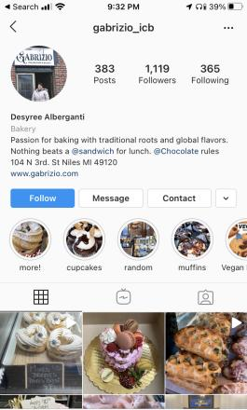
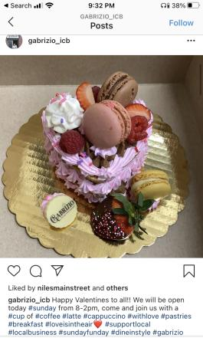
Example of How to Utilize Instagram
Notes:
The other platform I would recommend utilizing is instagram
Instagram is a more casual photo and video sharing app
On the main page you see the number of posts, followers, and following
Again, I recommend using your business name as the profile name and logo as the picture, keeps it a bit more professional
You would be a business account, which gives you access to insights like how many people view your profile
You’d put what category or industry you fall under
and a small biography that explains what you’re business does
You can also link your website to make it easy for users to find out more about your business
The circles under the biography are highlights from stories, which I’ll explain in a bit and then the posts
consistency is key
person that runs this is not professional photographer; doesn’t need to be professional

Slide 16
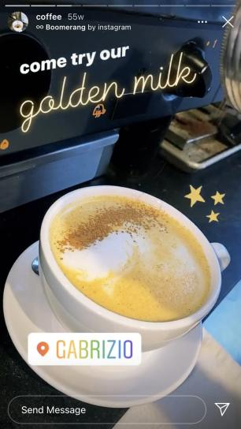

Notes:
So these are stories
They’re photos and videos you put on your account that appear for 24 hours
Its a very fun and creative way to post content
You can tag locations, stickers, draw, write, even repost other posts
All people have to do i press on your profile picture at the top of their feed page
After the 24 hours you can categorize your stories into highlights, making them all accessible on your profile

Slide 17

How to Boost a Post on Instagram
Same concept applies
Steps on how to boost a post on Instagram:
Click the “Promote” button at the bottom of your post
Choose an audience: options are automatic, local, and manual
Set your budget and duration: depending on how much you spend, Instagram will estimate how many people it will reach and how many clicks it will receive
Notes:
Instagram
1. Click the “Promote” button at the bottom of your post.
2. Pick a goal.
Before you boost your post, Instagram will ask you whether you want to attract more profile visits, website traffic, or promotion views. Whatever your goal is for the specific post you want to boost, make sure you choose the option that best aligns with it.
3. Choose an audience.
After choosing your goal, you can pick from three different targeting options: Automatic, Local, and Manual. Automatic tells Instagram to target people who are just like your followers, Local lets you target people in a specific location, and Manual lets you target specific people, places, or interests.
4. Set your budget and duration.
Instagram will estimate the expected reach and clicks that your post will attract after you set your post’s budget and ad duration.

Slide 18
General Tips:
Understand who your audience is:
Location
Age
Gender
What jobs are they trying to get done?
Understand your audience

Slide 19
General Tips:
DO: Write a clear ‘about’ section in your profile and include updated contact information.
DO: Give your posts a call to action – what do you want people to do?
DO: Check your grammar and spelling
DON’T: Always sell
DON’T: #Abuse #Hashtags
Understand your audience
Have a clear message and a complete profile

Slide 20
General Tips:
DO: Show images of your products, how things are made, etc.
DO: Introduce your team, take people inside your HQ
DO: Share customer testimonials or stories
DON’T: Post images or videos that are not yours
DON’T: Share visuals of individuals (especially children) without permission
Understand your audience
Have a clear message
Use visuals to tell a story

Slide 21
General Tips:
DO: Monitor and respond to reviews, complaints, and comments
DON’T: Engage the haters!
DO: Be transparent to gain trust
DON’T: Be needy – asking for likes, shares, re-tweets, etc. – or complain
DO: Keep it local! Share and tag other businesses in your posts
DON’T: Make promises you can’t keep
Understand your audience
Have a clear message
Use visuals to tell a story
Interact with your audience
Notes:
any way to cross promote products with other local businesses is very useful

Slide 22
General Tips:
DO: Have a consistent brand, logo, name, look and feel across all platforms
DO: Ensure you have an updated profile (e.g. hours of operation, location, website, deals, etc.)
DO: Post regularly to keep content fresh (1-2 times per week) – it’s easy to create your social media presence, but the hardest part is to maintain it!
DON’T: expect results overnight
Understand your audience
Have a clear message
Use visuals to tell a story
Interact with your audience
Be consistent

Slide 23
General Tips:
DO: Separate your personal and professional accounts
DO: Be careful when posting from a personal phone or computer
DON’T: Post your political, social, or religious views on your business account
Understand your audience
Have a clear message
Use visuals to tell a story
Interact with your audience
Be consistent
Keep it professional
Notes:
DO: Separate your personal and professional accounts
It’s ok to share with your family / friends, but keep personal conversations on your personal accounts
It’s ok to share useful business info on your personal pages, but be sure to distinguish between the two so people know where to go for info (e.g. hairdresser)
Keep your personal accounts private. People buy from people – you can still keep your personality on your business page without getting too personal
DO: Be careful when posting from a personal phone or computer
Double-check images / videos being posted
Be sure to check which account you are sending things to
Don’t post under the influence!
DON’T: Post your political, social, or religious views on your business account
You are entitled to post this on personal accounts, but sharing on your business account could alienate potential clients who haven’t even worked with you yet. Best to avoid anything that could stir negative comments or controversy

