Slide 1
Social Media and Marketing
Michael H. Morris
Keough School of Global Affairs
University of Notre Dame
Dr. Michael Morris

Slide 2
“There is no such thing as a free lunch.” -various

Slide 3
Social media everywhere…
Social media is:
- an online, open communication channel
- interactive and encourages participation
- includes user-generated content
- enables development of networks/communities
Includes blogs, podcasts, business networks, social networks, photo and video sharing, forums, social bookmarking, wikis, social gaming, virtual worlds and more
Today includes hundreds of different online communication vehicles:
Facebook LinkedIn Twitter Badoo Flickr TravBuddy VineCamera
QQ Skype Google + Foursquare Pinterest Classmates Meetup
Whatsapp Instagram Tumblr MeetMe Buzznet WeeWorld Ask.fm
Viber Snapchat Reddit Kiwibox YouTube LiveJournal Snapfish

Slide 4
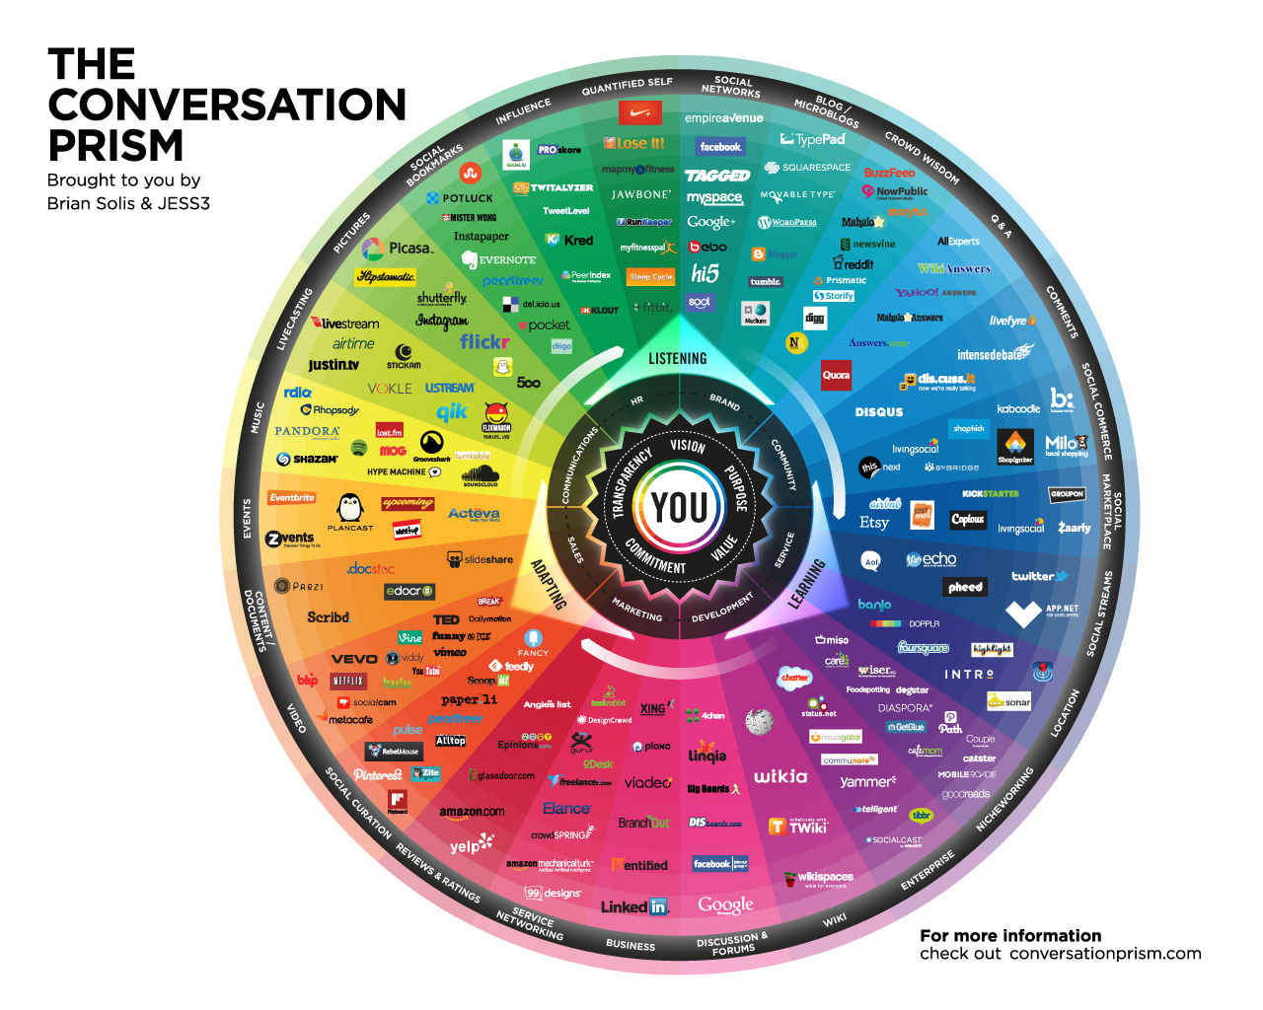

Slide 5
Social media vs traditional media
Quality: quality is more variable with social media (SM)
Reach: Both have high potential reach, but SM is more decentralized, less hierarchical, and distinguished by multiple points of production and use (organic reach w/Facebook is declining)
Frequency: especially with heavy SM users, it is possible to create greater frequency of exposure to a message at lower cost
Targeting: SM allows for much more specific targeting
Effort required: With social media you have to work at it constantly, not just design and run
Accessibility: SM is easy to access from anywhere, any time
Ease of use: SM requires less skill than conventional media
Cost: SM can be dramatically cheaper but requires significant time to do it right
Speed: SM can get messages out quickly, but it takes time to build an audience
Branded content: with exceptions (Axe, Dove) SM users resist/ignore branded content
Flexibility/permanence: SM communications can be easily altered/updated
Metrics: more SM performance metrics are available and available more quickly

Slide 6
Social media marketing
Gaining traffic for your business through social media sites
Trying to grow ‘organic reach’ --- people exposed to your posts NOT as a result of online ads
Need to ensure your prospective customers are using a given SM channel (e.g., Facebook)
So you are trying to drive the right people to your Facebook business page (or follow you on Twitter, Instagram, etc.)

Slide 7
Social media marketing
Attempting to ???
- simply create awareness;
- generate leads;
- educate prospects;
- generate ‘likes’ and get people to invite friends to follow you;
- get people to call or email you;
- motivate them to link through to your website;
- move them to act (buy); build a community around your business
(depends on SM channel)
Most often, you are trying to get them off your Facebook page (or twitter, etc.) and onto your website (platform where they can act)

Slide 8
Traditional marketing has been termed “outbound marketing”
Critics call it interruption-based
Use of SM and your website for marketing is termed “inbound marketing”
Proponents call it permission-based

Slide 9
Correcting misconceptions
While SM can be done quickly and flexibly, it does not mean quick sales
SM is in effect establishing a dialog with a person who might become a customer with time --- but it takes time to convert --- more time than internet advertising or conventional advertising
It is harder and harder to achieve organic reach through SM
While SM allows broad targeting, it may be more effective in local markets
Experts argue that effectiveness requires that SM efforts be combined with online advertising (including on SM sites)

Slide 10
SM channel plans
Pick a theme
Pick a channel (e.g. Twitter, Facebook) based on your objectives (note that you can get demographics and other data on each channel)
Determine who you are trying to reach with this channel
Determine communication objectives --- behavior you are trying to stimulate
Determine when you want to reach them
Determine type of content (text, video, graphics)
Determine structure of a post
Determine tone (funny, informative, playful, sarcastic, etc.)
Determine schedule of posts
Determine performance metrics
Note: you need distinct approaches to each SM channel

Slide 11
Sample tips for driving traffic
You drive traffic by using keywords in your profile, adding posts related to your product that people are most likely to search for
Emphasize what you have done, not just who you are
Give your company a personality
Use images and videos --- they generate more likes, shares and comments
Convey content through infographics
Post links to your Facebook page on other social media (Twitter, Whatsapp, etc.)
Create posts to your page frequently (post more & get more metrics on what works)
Be aware of optimal times for posting to different SM channels (e.g., Facebook is 1-4 pm while Pinterest is 8-11 pm)
Have a strategy for the mix of links, photos, videos, quotes, content updates and reshares you are posting
Connect your business page to your personal page profile

Slide 12
More tips for driving traffic
Link your Facebook page to a blog or YouTube channel that you create
Interact with followers --- respond on timely basis
Be personal and personable in posts
Avoid buzzwords
Provide an interesting number (fact)
Place partial content that teases or intrigues on one platform (e.g., Instagram) where person must link to your Facebook page to get the rest of the story
Add your Facebook business page link to your email signature
Have people vote on things (e.g., a product name)
Getting influencers (e.g., big people in industry) to blog, tweet or otherwise post about you
Partner on SM with related product or service providers
Dedicate time ---some argue for an hour per day per SM channel

Slide 13
Social media and crowds
Through social media, crowds now exist around virtually any topic
(extreme sports, salsa dancing, investment strategies for 20-somethings, microbrews, local pizza lovers, the radical left, new art forms, water diets, etc., etc., etc.)
You can immerse yourself into such networks or movements---sending posts to groups, reposting their stuff, engaging with members
Phlex example

Slide 14
Using blogs
Very popular if substance-rich, informative, factual, enjoyable (not selling)
A luggage retailer might create a blog on how to pack and the kind of bag to use for various kinds of trips
Google will index blogs and those become pages that show up when people search in the future
Tie blog to your Facebook page and website
Get prominent people to guest blog for you

Slide 15
Boosting a post (for a fee)
Pick a post on your Facebook page you want to boost
Click ‘boost post’ on your Facebook page (so it is super easy)
Select an audience you want to target (this is key, as you are likely to reach a lot of people you do not really want)
Choose a budget and campaign duration
Boost when (days and times) the people you are targeting are online/active
Boost posts that have high quality images or videos
Be careful on what you are spending, as Facebook ads may cost more, but tend to be much more effective, with many more options

Slide 16
Setting objectives based on metrics
click through rates, bounce rate (people leave your site after only viewing 1 page), time on site
leads generated, web referrals (visitors to your site from direct links on other sites), and conversion rate
share of traffic driven to your website by social media (vs. search or ads), social share of voice (% of mentions within the industry are about your brand vs. % about the competition)

Slide 17
Continually learn from the data
Spend time assessing the different demographics (and interests and related descriptors) as they relate to who:
- visits your page
- likes your page
- likes a post
refers you to others
calls you based on your facebook page
clicks through to your website
visits multiple pages on your website
visits your website multiple times
buys from you
makes repeat purchases
You can also get metrics on what your competitors are doing on social media

Slide 18
A slew of services to help
Followerwonk - helps examine analytics and see characteristics of your followers
Hootsuite – provides dashboard for managing multiple social media channels
Buffer app – automates your posts on a schedule
Webimax – provides social media marketing services
OrangeSoda – assists with geotargeting of marketing efforts
Venngage – helps users create great infographics online
Fiverr - offers freelance services to entrepreneurs (graphics, digital marketing, writing)
HubSpot - provides software products (e.g., CRM) for inbound marketing
Mailchimp – offers an email marketing service
Lithium – helps companies manage communities of users
BuzzSumo – finds names of influencers, prominent people in your industry
Scripted.com – offers writers to create contents, posts

